Slide 1
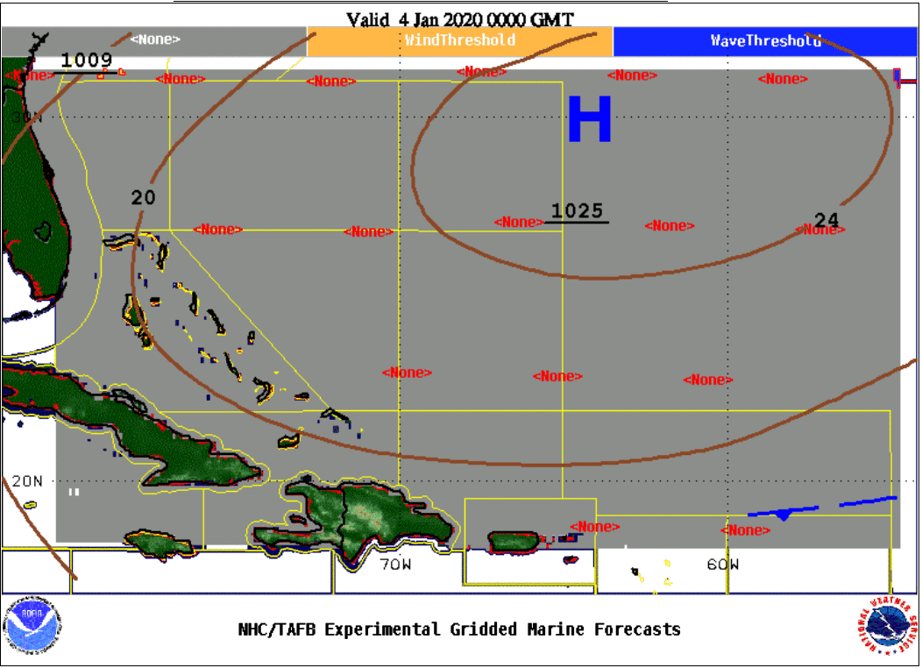
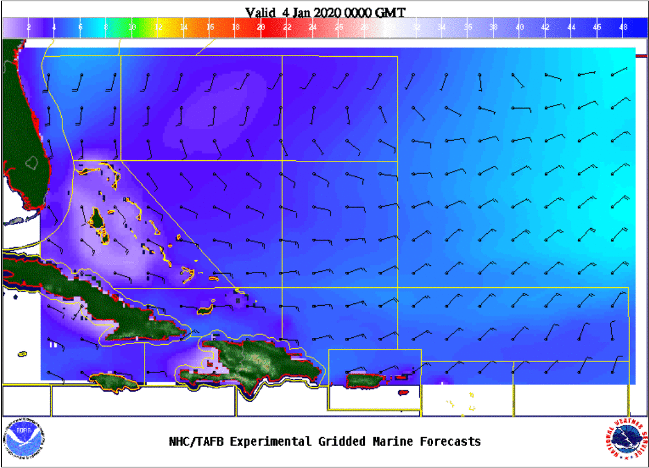
Atlantic Polygon Example
Colors: Seas (in feet)
Flags: Wind barbs (in knots)

Slide 2
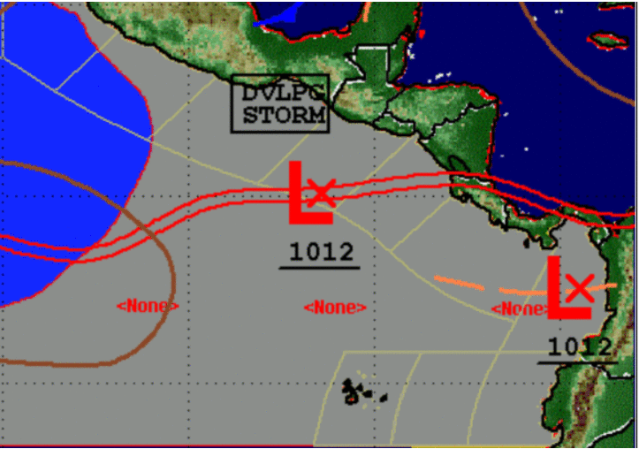
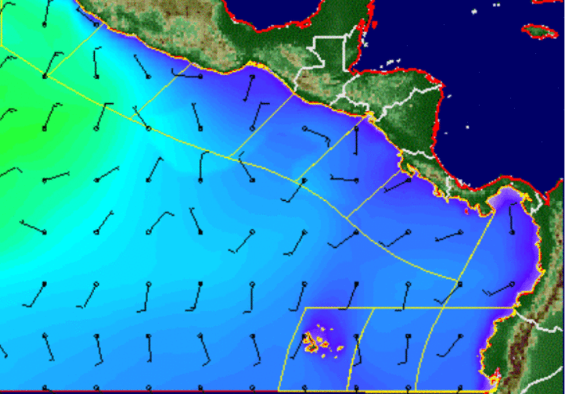
Eastern North Pacific Polygon Example
Colors: Seas (in feet)
Flags: Wind barbs (in knots)

